Slide 1
The Battle of the Neighbourhoods – A Comparison of Neighbourhood Features in Major Financial Capitals
Samuel Lee
9th October, 2019
Project github repository: https://github.com/Sam-Lee1/Coursera_Capstone

Slide 2
Introduction
It can be difficult to find the type of place we’re looking for when moving or travelling to new places. We will analyse and present data about neighbourhoods around the world to help solve this problem, by making it easier to understand what different areas will be like.
We will analyse and compare neighbourhoods in major financial capitals around the world; London, New York, Frankfurt and Toronto.
We will leverage Foursquare venue data to analyse and categorise venues in postcode areas, and use this venue data to cluster similar postcode areas and categorise them.
We will explore how we can further leverage this data – to find potential gaps in the market or to further build on our comparisons.

Slide 3
Data Acquisition and Cleaning
Post/zip code area data scraped from Mapawi for Frankfurt and Doogal for London. Coordinate data for these areas geocoded using the geopy python extension.
Toronto post code data scraped from Wikipedia, coordinates uploaded from cognitive class.
New York neighbourhood and coordinate data uploaded from the the NYU spatial data repository.
Our cleaned neighbourhood area data set totals 583 neighbourhoods across our 4 cities.
Nearby venues for each neighbourhood pulled from foursquare.

Slide 4
Data Analysis
We will take the category of each venue near our neighbourhoods, use one hot encoding and take the relative frequency of each category for each neighbourhood.
We will then perform k-means clusters analysis on all the neighbourhoods, in the entire inter-city dataset. We will then characterise these clusters, based on the features of these neighbourhoods.
We shall breakdown the results of our k-means cluster analysis and represent the clustered data on a labelled map, centred on each of our cities.
Further, we shall evaluate the sum of the mean square differences of the relative frequency of neighbourhood cluster types between our cities and tabulate the results.

Slide 5
Cluster Breakdown
Cluster 0, labelled ‘Theme Parks and Recreation’ due to high frequency of each near these neighbourhoods, coloured red, 24 neighbourhoods
Cluster 1, labelled ‘Coffee Shops, Cafes and Pubs’ due to high frequency of each in neighbourhoods, coloured purple, 149 neighbourhoods
Cluster 2, labelled ‘World Foods’ due to variety of restaurants serving cuisine from around the world, coloured blue, 242 neighbourhoods
Cluster 3, labelled ‘Pizza Places and Fast Food’ due to high frequency of both in neighbourhoods, coloured turquoise, 62 neighbourhoods
Cluster 4, labelled ‘Green and Peaceful Spaces’ due to high frequency of both in neighbourhoods, coloured green, 14 neighbourhoods
Cluster 5, labelled ‘Convenience Stores’ due to high frequency of various shops, convenience stores in neighbourhoods, coloured yellow, 87 neighbourhoods

Slide 6
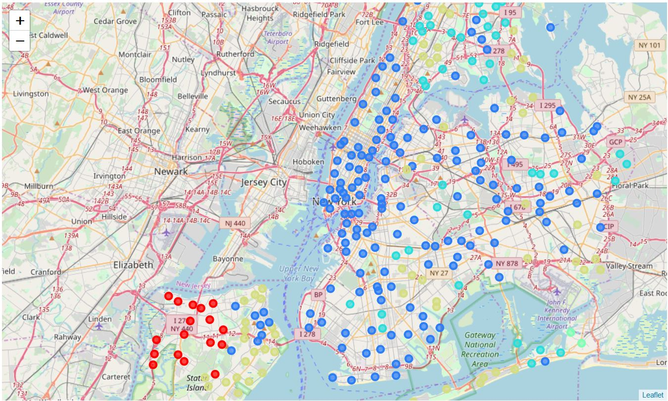
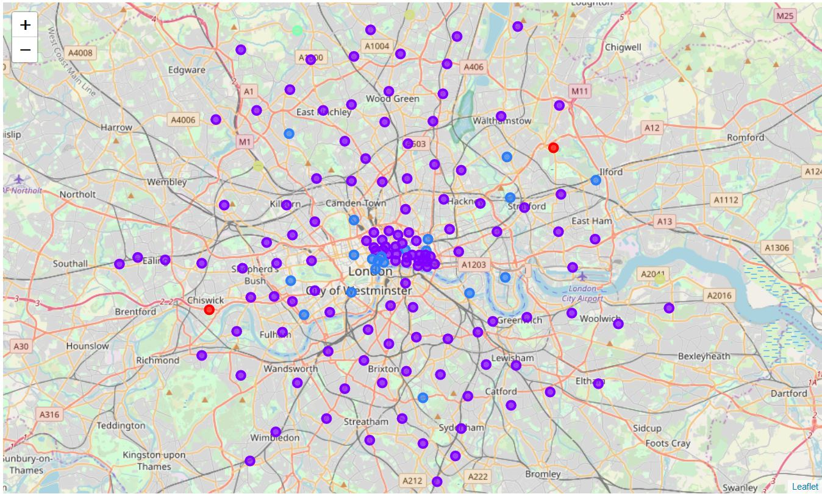
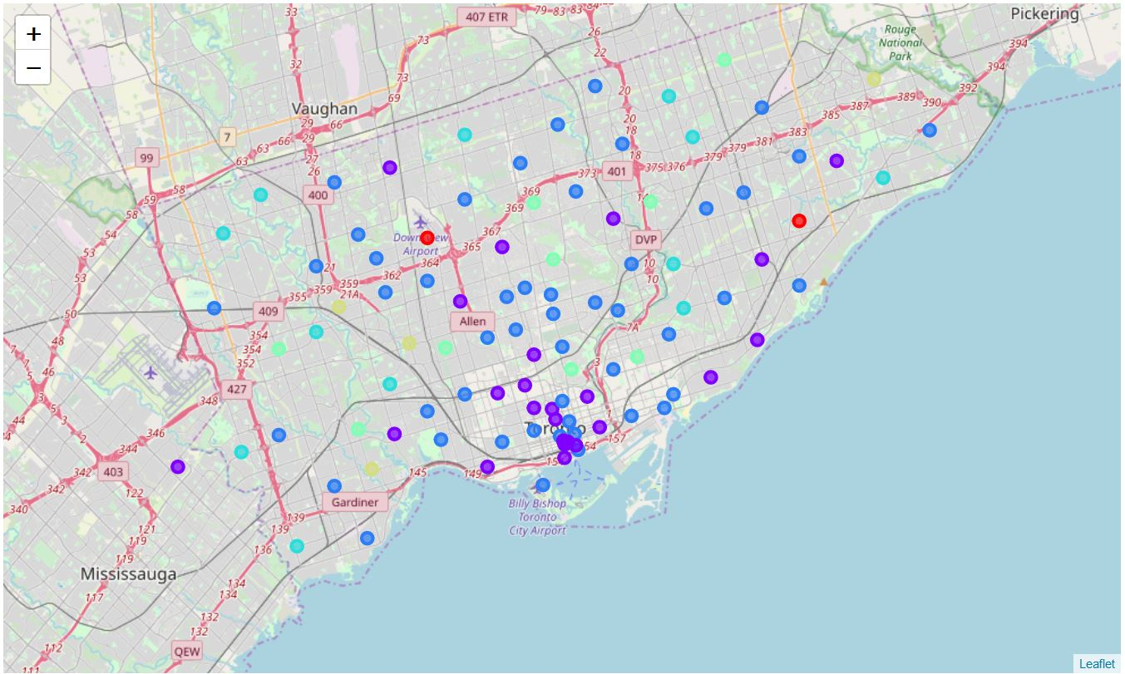
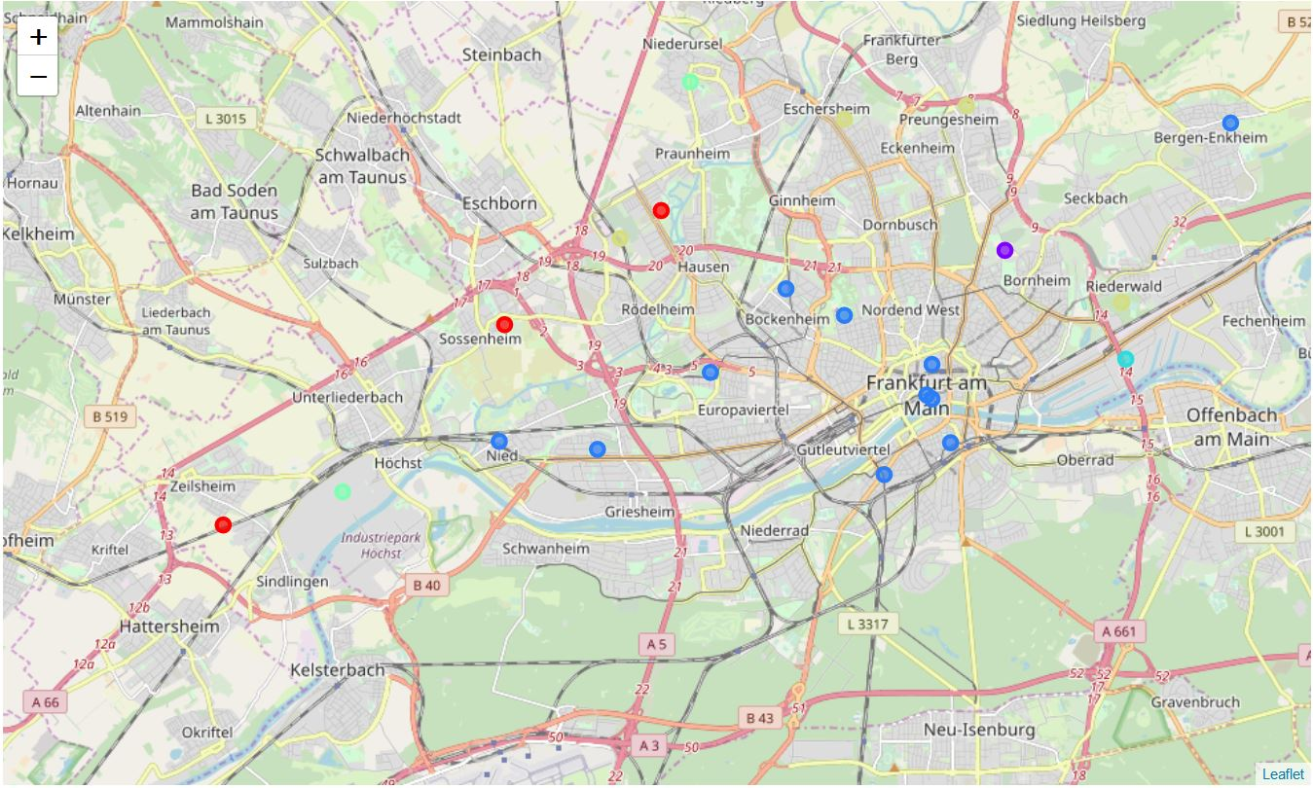
New York
London
Interactive, labelled map: https://nbviewer.jupyter.org/github/Sam-Lee1/Coursera_Capstone/blob/master/Interactive%20Map.ipynb
Toronto
Frankfurt

Slide 7
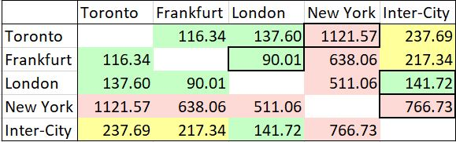
Relative Similarity Between Cities
Here we found the sum of the mean square differences of the relative frequency of neighbourhood cluster types between each city.
The more similar cities have been colour coded green, to the least similar red and the most similar and dissimilar cities to each other and the inter-city dataset have been highlighted

Slide 8
Conclusion and Possible Future Directions
We’ve clustered and characterised 578 neighbourhoods across four cities.
The most similar neighbourhood distribution between our cities was that of London and Frankfurt, and London had the most similar distribution to the overall dataset. New York and Toronto were the most dissimilar, and New York was the most dissimilar city to our overall dataset.
In future we could scale up the concept, to include more cities across more countries or take a more thorough look at an individual country.
The true potential of this methodology could be unlocked by building an application based on the data – features such as choosing your neighbourhood and finding the most similar to it in an area, or searching for neighbourhoods based on desired features could provide easy access to and interpretation of the data for an end user

